Slide 2

11 Shocking Mistakes
Retailers Are Making
On The Mobile Web
Brian Klais, Founder

Slide 3
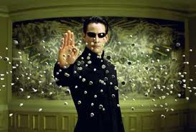

Slide 4
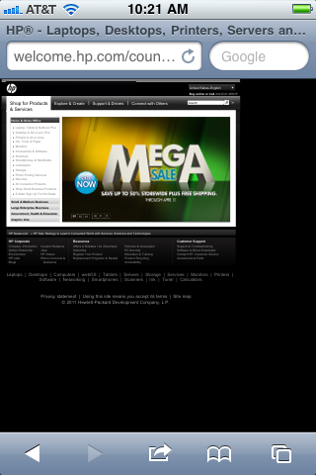
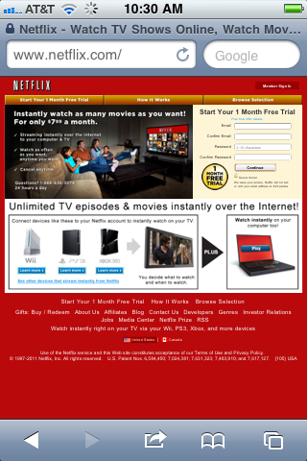
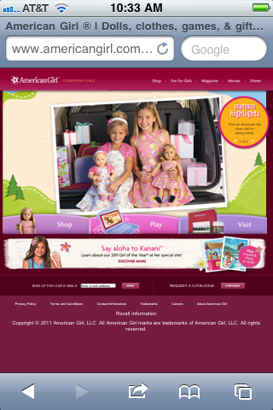
#1: Mobilize Already!
@hp @netflix @americangirl: hunt, pinch, zoom, type, think = bounce

Slide 5
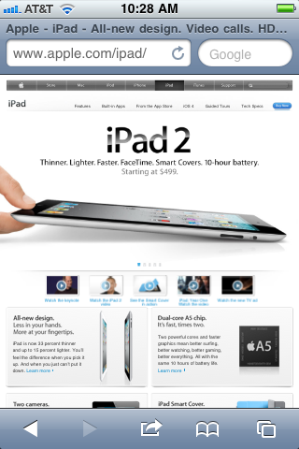
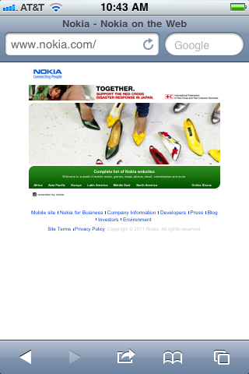
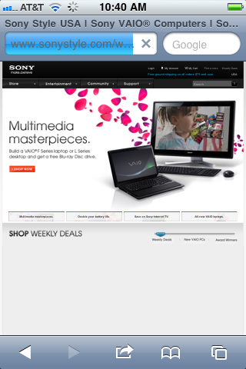
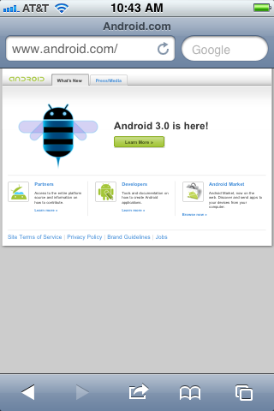
#1: Mobilize Already!
… unless u sell smartphones!
@apple @nokia @android @htc @sony @moto @samsung etc we <3 u

Slide 6
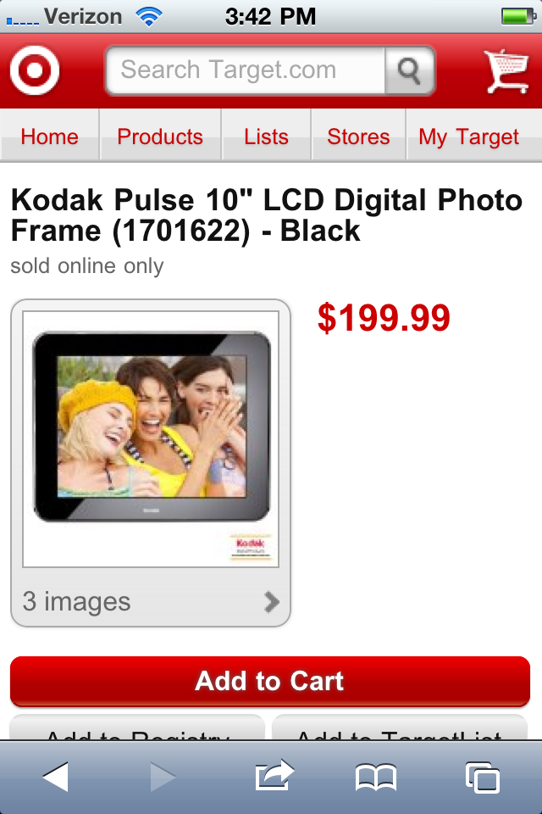
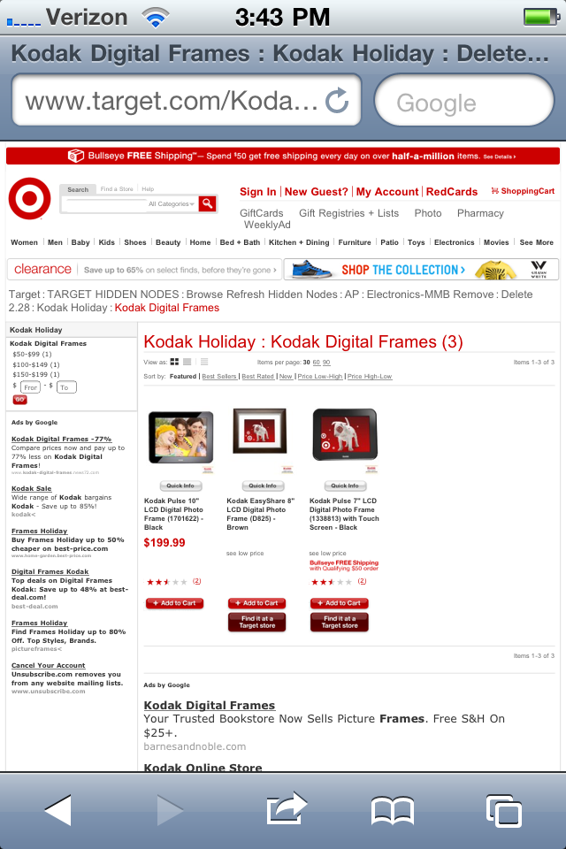
#2: Detect My Device
@target: surprise! we want this page instead :-)

Slide 7
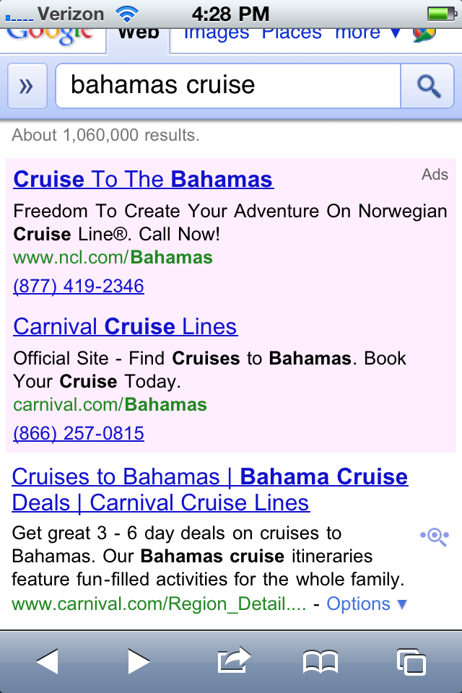
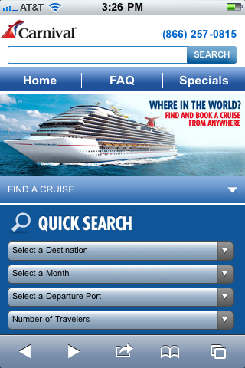
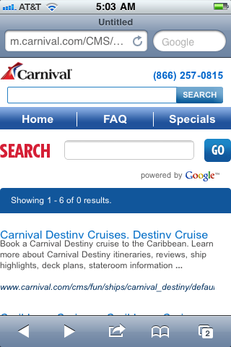
#3: Redirect Me Intelligently
@carnival: want 2 cruise - not in circles :-(
Notes:
Organic search and shopping feed services depend on native site URLs that are submitted or crawled. When mobile searchers select these high ranking links, mobile user get directed to the brand’s mobile home page, instead of the product or category page requested. While not as egregious as the Zappos example, the mobile searcher is again given a reason to bounce back to Google and select another brand.
The culprit in these scenarios is typically the mobile “sniffing” technology used to detect smartphone users and then redirect them to a more mobile-friendly page. In cases like Zappos, they may not offer a mobile friendly page for that product or category. In the case of mobile platforms, they have not properly mapped the native URL request to the mobile platform URL. As a result, the sniffer logic either breaks or simply produces bad user experience. In a future article I’ll cover the analytic issues with this problem—how it goes under the radar, how to create visibility and guard your brand from falling victim to it.
Now imagine if Zappos had provided a smarter mobile 404 page, programmed to parse the referral URL, extract the search query, and provide the mobile user with pre-loaded clickable query link (for example, “continue shopping Zappos for men’s wool socks here”) which executes an internal search query when clicked. This mobile page would have been more helpful and actionable for mobile users, and may have given Zappos a second chance to earn the business.
clickstream from search
ROI
listening for internal search results
examples:
evidence:
google sats on mobile search? mobile query volume growth of 500%
advice:
link to article on itnegrating mobile search into requirements
http://www.pureoxygenmobile.com/3-tips-to-detect-fix-mobile-search-leaks-improve-your-ctr/
Or consider brands like Home Depot that use a separate mobile platform to render mobile optimized pages. Organic search and shopping feed services depend on native site URLs that are submitted or crawled. When mobile searchers select these high ranking links, mobile user get directed to the brand’s mobile home page, instead of the product or category page requested. While not as egregious as the Zappos example, the mobile searcher is again given a reason to bounce back to Google and select another brand.

Slide 8
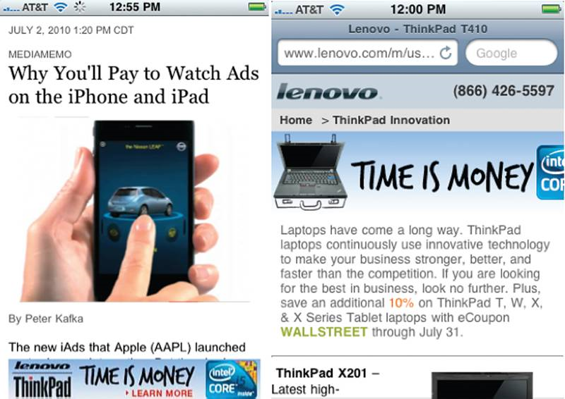
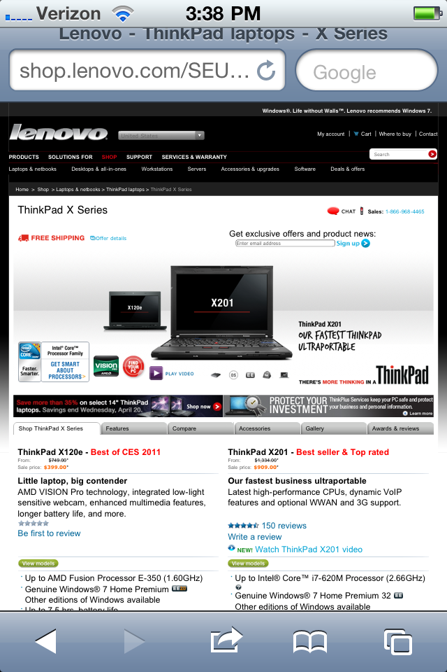
#4: Win Me Post-Click
@lenovo: ‘time is money’ - thx 4 wasting mine
Notes:
landing page page is good, second page sucks
display, search
examples:
Lenovo Zappos
evidence:
http://www.pureoxygenmobile.com/3-tips-to-detect-fix-mobile-search-leaks-improve-your-ctr/
advice:
need mobile clickstream intelligence
tool to analyze - PO2 to assess 100 pages get free analysis

Slide 9
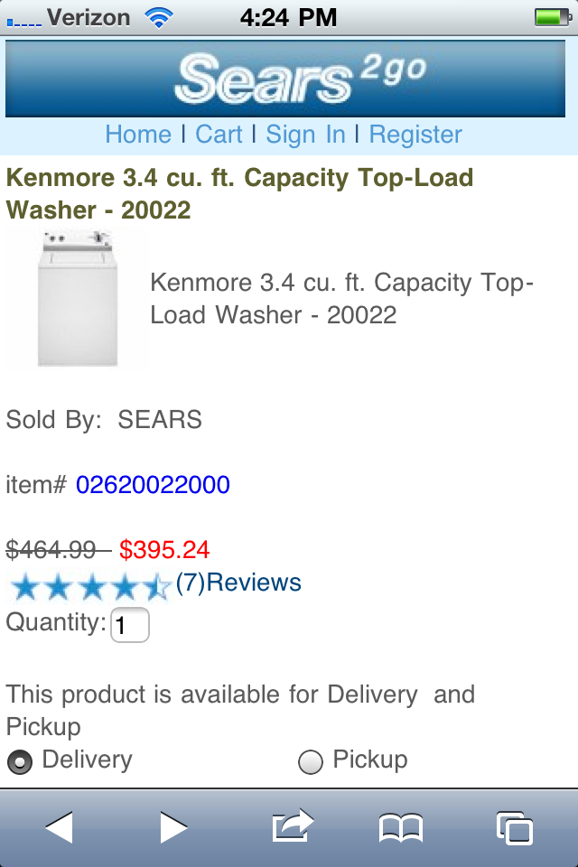
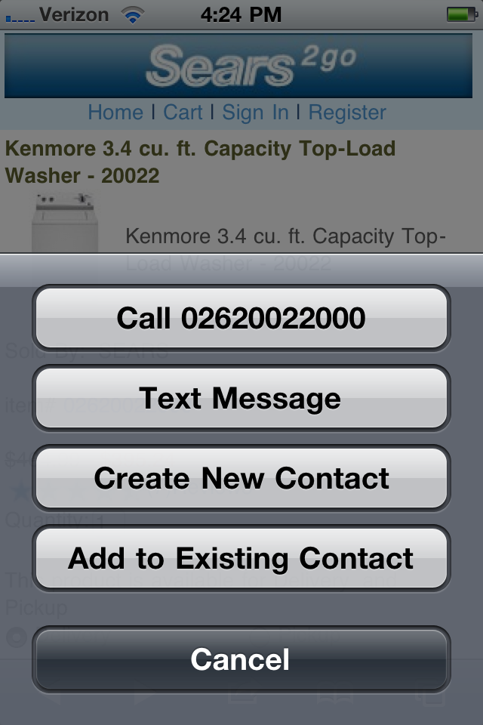
#5: Integrate Click-to-Call
@sears: need new washer asap, million ?s, how do i talk 2 u? ahh!

Slide 10
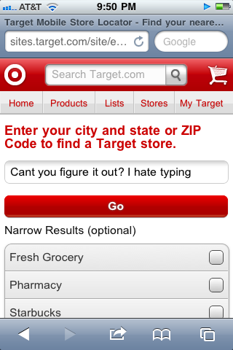
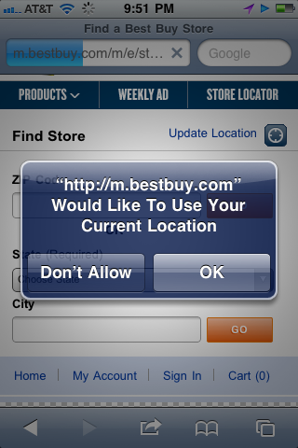
#6: Don’t Make Me Type Geo!
@target: hello driving … don’t make type my zip!
@bestbuy: yay! ur awesome

Slide 11
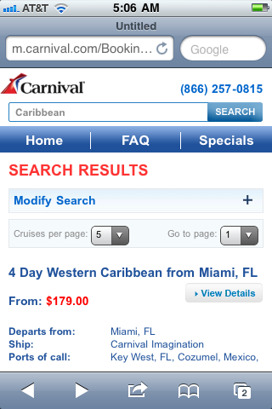
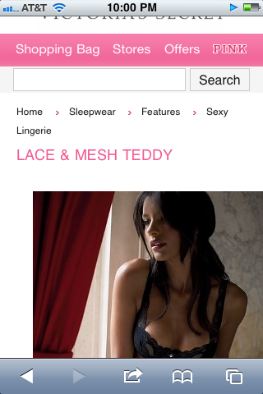
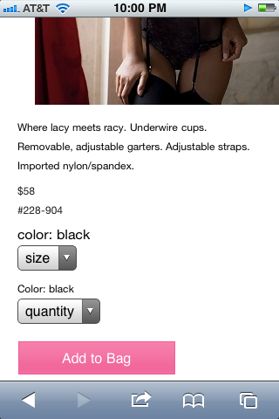
#7: Let Me Socialize Your Product
@carnival: want 2 fb / tweet to friends!
@victoriassecret: let me sms to wife :D

Slide 12
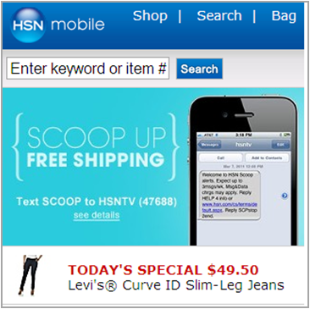
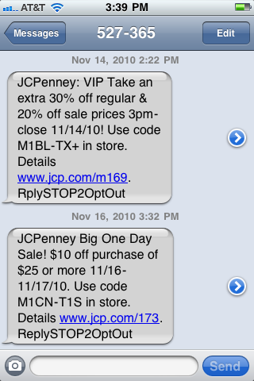
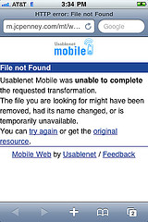
#8: I Want Your Texts
@hsn: can’t type now, link to sms plz?
@jcp: 3 bad links in a row … wtf?

Slide 13
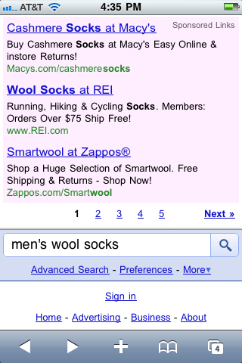
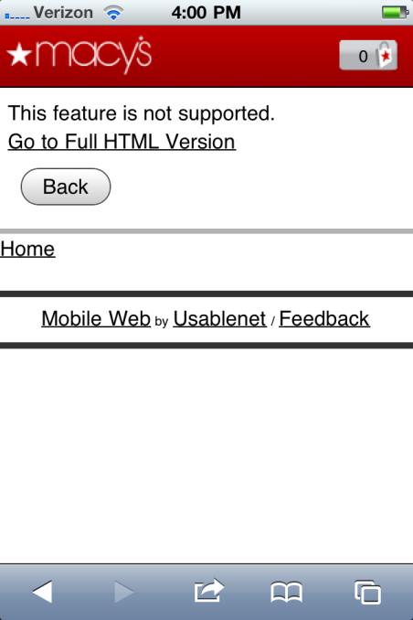
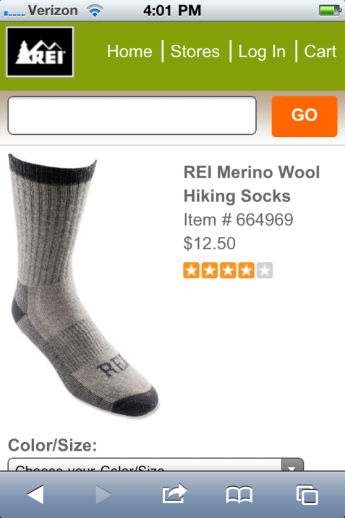
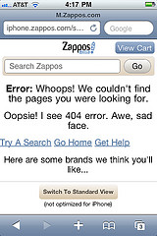
#9: Optimize Your Ads
@rei: u could have had me @ ‘hello’

Slide 14
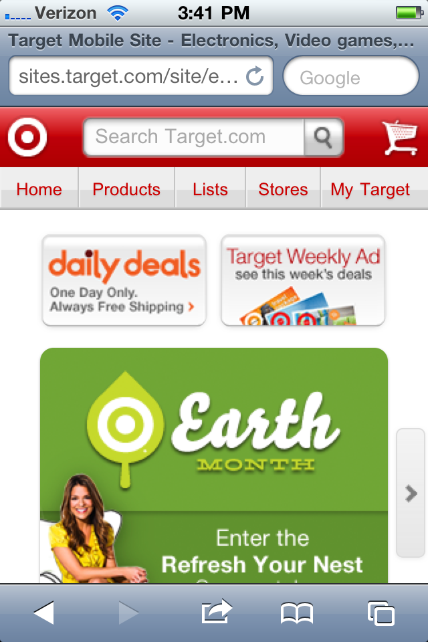
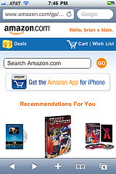
#10: Help Me Find Your App
@target: where’s waldo?
@amazon: yay!

Slide 15
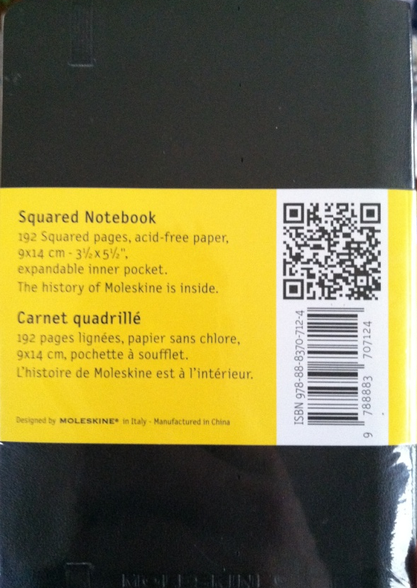
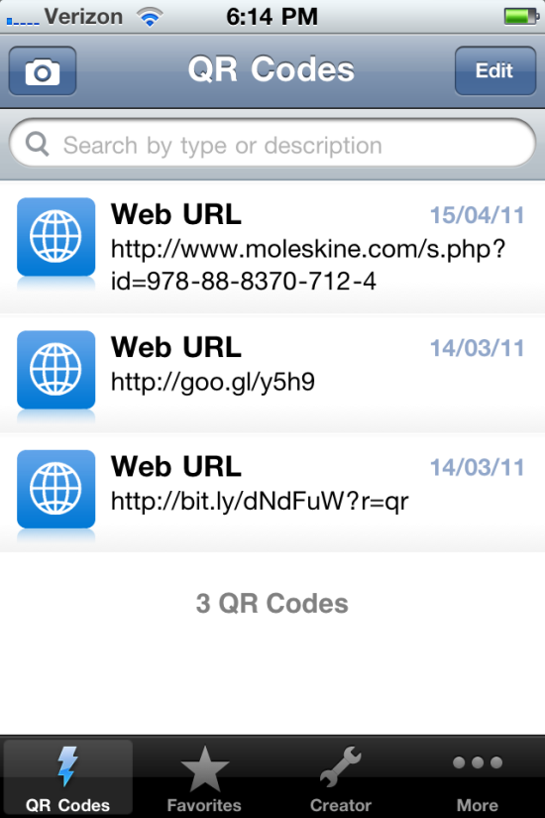
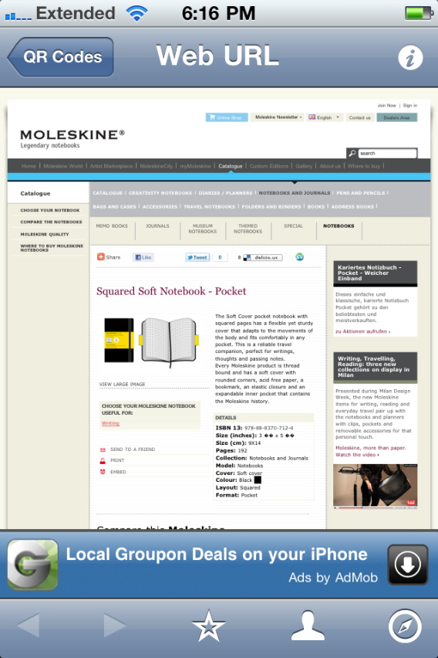
#11: Scan Beats Search
@moleskine: smart! @amazon: you lose

Slide 16
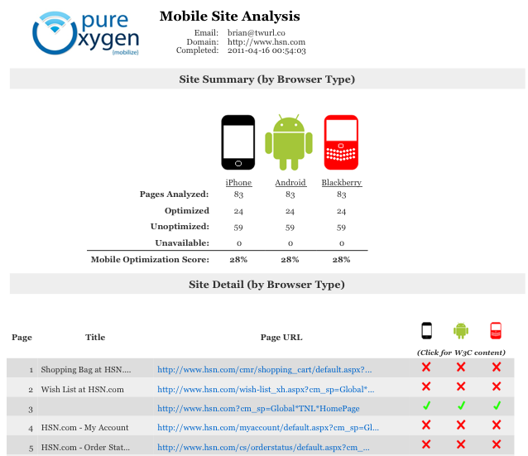
Announcing: Mobile Site Auditor (Beta)
Go to: po2.co/msa
Enter email & URL
Analyze 100 pages
Optimize conversion

Slide 17




Mobile Web Doesn’t Have to Suck
thank you! @brianklais
Notes:
Analysis, strategy, and tools to maximize conversion
Optimizing mobile web, search, and social commerce

